Slide 1
The Future of Blockchain
By Paras Dalal

Slide 2
What Do I Plan to Cover
Problems that we want to solve
General concept of Blockchain
Overview of How it is implemented
Common uses of Blockchain
Problems of Blockchain
Is it relevant to Bessemer?
Summary

Slide 3
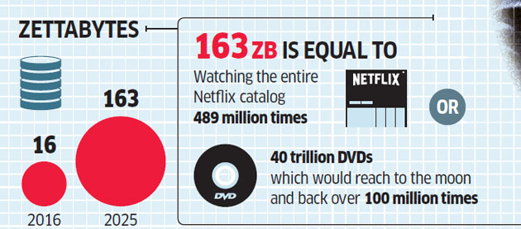
Problems that we want to solve
Data Overflow
1,000,000,000,000,000,000,000 (10²¹ = 1 Billion Terabytes)

Slide 4

Problems that we want to solve
Data Security

Slide 5
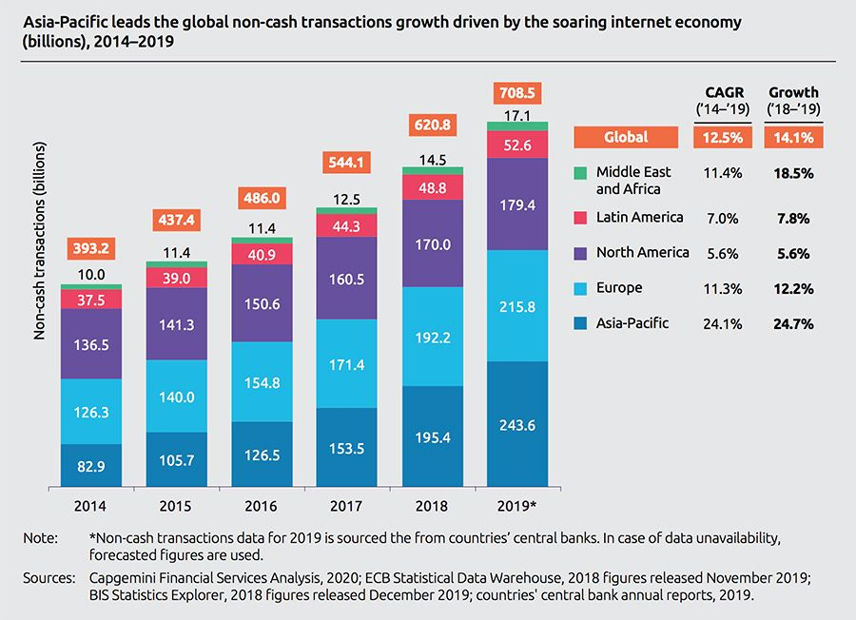
Problems that we want to solve
Transactions

Slide 6
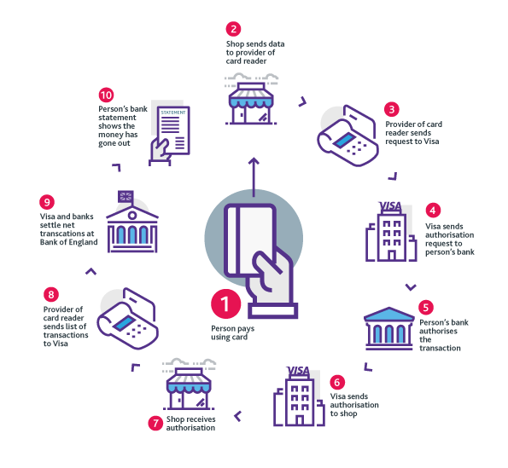
Problems that we want to solve
Intermediaries

Slide 7
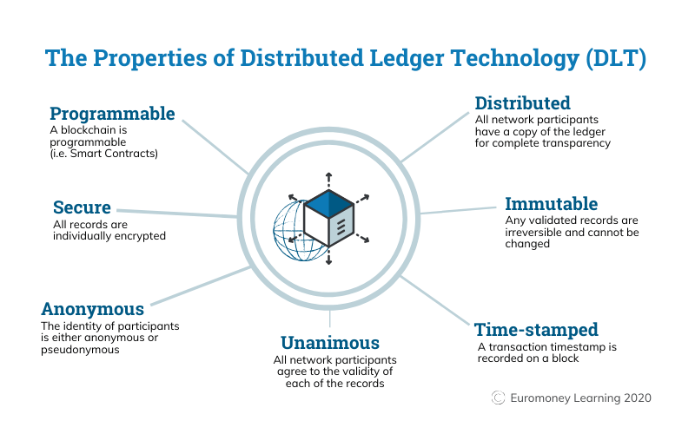
General concept of Blockchain
Blockchain is a type of Distributed Ledger Technology

Slide 8
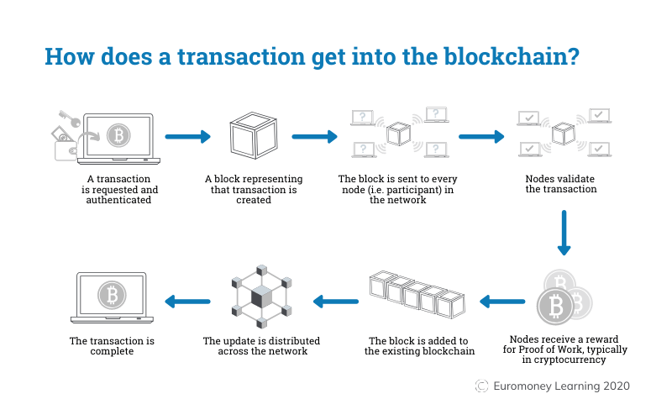
Overview of How it is implemented

Slide 9
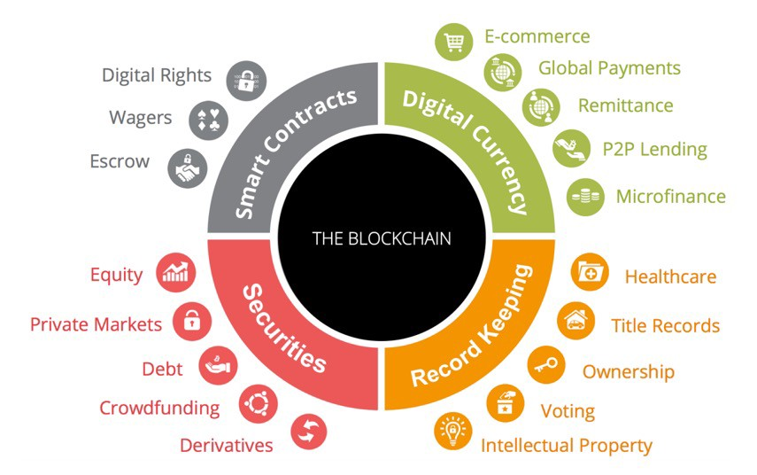
Common uses of Blockchain

Slide 10
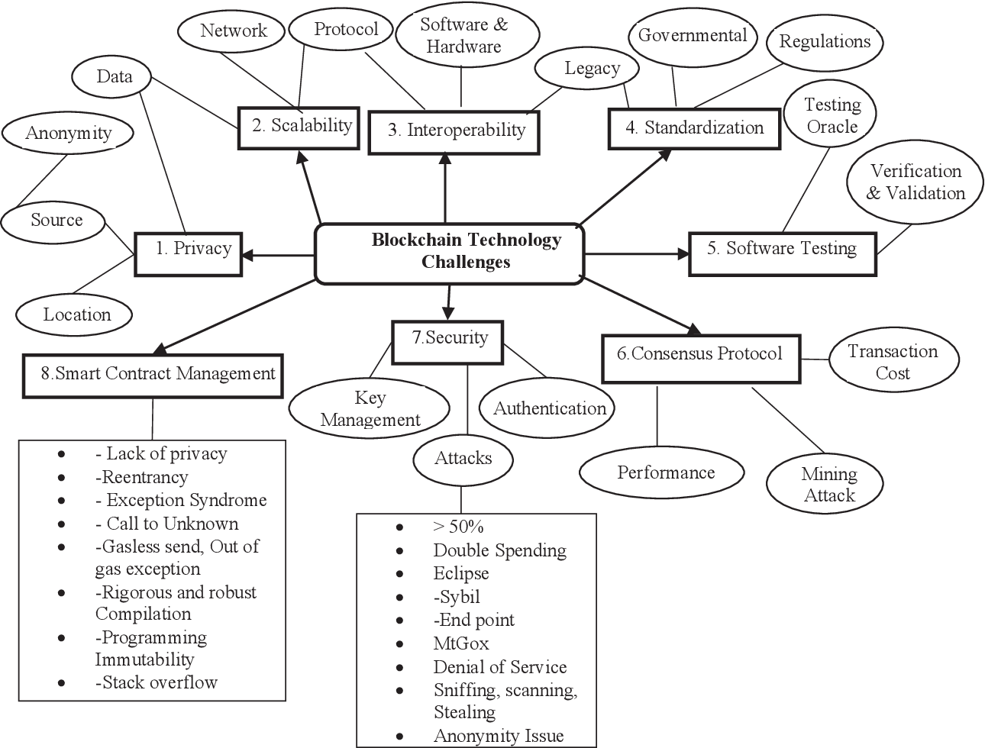
Problems of Blockchain

Slide 11
Is it relevant to Bessemer?
Can have local data on Client Advisor desktop for all the clients handled by them for easy offline access
May need to participate in public blockchain for settlement processing (Settlement using smart contracts – zero day settlement period)
May need to be aware of the crypto positions and/or digital assets of clients and actively participate in the legacy planning for smooth handover to next generations

Slide 12
Summary
Relevant where
Need to distribute data (For safety, speed, volume)
Need to be certain about data quality (Every block is authenticated – hash functions)
Need to involve multiple parties in a transaction (Immutable, Time stamped, confirmation as soon as it happens)
Need to have confidential information storage (Cryptography)

Slide 13


